Slide 1


Building Resiliency
A solution to build new nurse resiliency
Notes:
As a new nurse on one of my earliest shifts, my 2-year-old trauma patient died in my arms. Instead of taking advantage of live debriefs and the resources available to me, I left overwhelmed and not wanting to spend another minute in the hospital. I slowly learned to push feelings aside. I know that this story isn’t unique to me and every single person here with us today carries similar experiences.

Slide 2
$1.4 to $2.9 billion
$22,000 to $64,000
30-69%
Building Resiliency
Per year are lost by healthcare organizations in the US alone
Is the cost of replacing a registered nurse
Of new nurses leave their positions within the first year
Notes:
It costs $22,000->$64,000 to replace each registered nurse
New nurse turnover costs organizations in the United States approximately $1.4 billion to $2.9 billion per year (Meyer, Shatto, Delicath, & von der Lancken, 2017; Ulrich et al., 2010).
Studies show that between 30-69% of new nurses left their position within the first year
Other studies have shown that 17% of new nurses leave the profession within the first year and 30% within the first 3 years (Sutor and Painter, 2020).
According to the Robert Wood Johnson Foundation, the cost of replacing a registered nurse ranges from about $22,000 to more than $64,000 (RWJF, 2007).
There is not adequate focus on well-being due to focus on achieving clinical competence during orientation. However, according to Reebals, Wood, Markaki (2021) emotional support for new graduates was instrumental to achieving clinical competence.
Nurse leaders (educators and managers) may lack bandwidth to identify early signs of destress to intervene before employee leaves.
It is crucial to provide adequate emotional support to new nurses in order to decrease costly turnover.

Slide 3
Perception vs. Reality
Building Resiliency
Overwhelming experiences
Moral distress
Burnout
Compassion Fatigue
Learning Multiple Systems
New EHRs
Multiple technologies
Coordinating communication
I am finally going to get to help people.
Competency Building
More check-offs
Rapid skill attainment
Tons of paperwork
Overloaded support systems
Nurse leaders, educators, and preceptors are limited in capacity themselves
Notes:
There is a perception gap in the new nurse’s learning experience and their support systems are overloaded trying to replace a fleeing and depleted workforce.
And none of the solutions to combat this attrition truly center on lightening the cognitive load and promoting the wellness of the new nurse.

Slide 4

Parachute
Building Resiliency
A nurse-centric mobile app that promotes resiliency, wellness, and retention of new nurses in acute care settings.
PARACHUTE
Icon taken from Good Ware from Flaticon.com
Notes:
That’s why we created Parachute, which is a nurse-centric mobile app that promotes resiliency, wellness, and retention of new nurses in acute care settings.

Slide 5
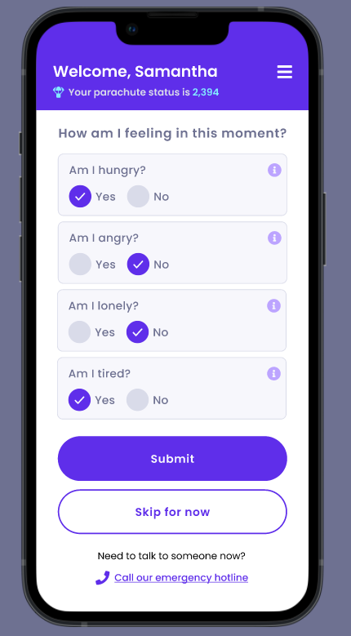
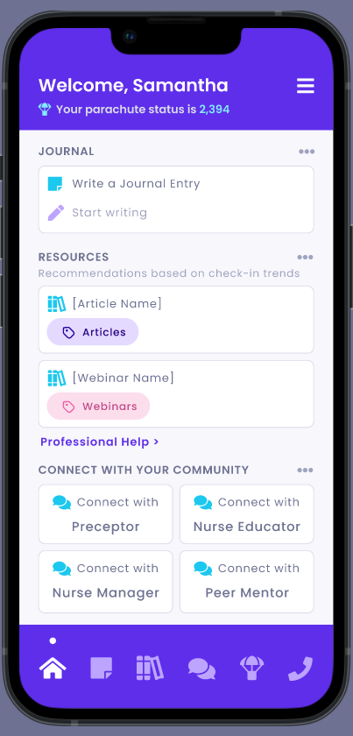
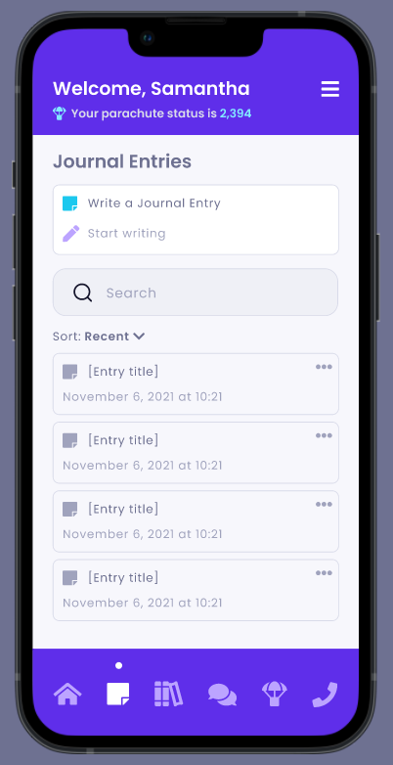
Building Resiliency
Access professional services
Share journal entries
Notes:
Our mobile app features opportunities for reflection through a daily check-in or through journaling, access to dynamically changing resources based off of trends in check-ins (which are viewable in a dashboard), and most importantly connection to mental health providers, counselors, and coaches when you need it. Nurses have the option to connect with their internal community and even share their journal entries.

Slide 6
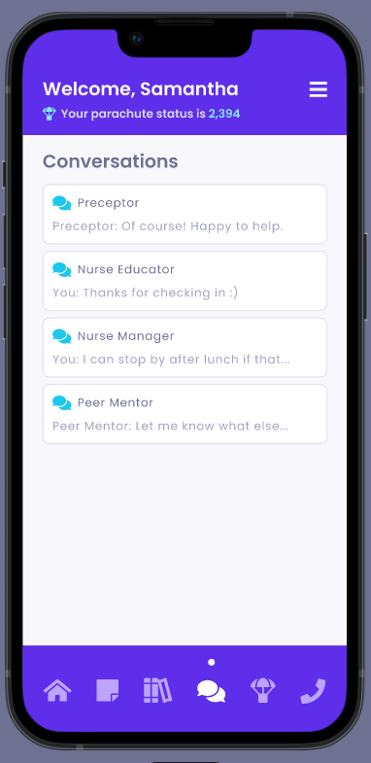
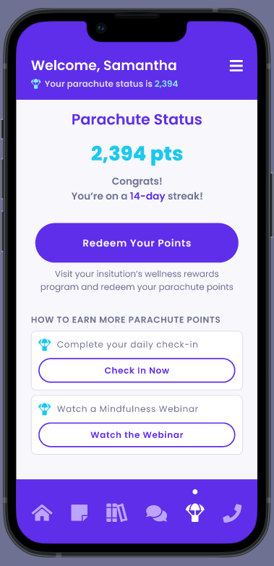
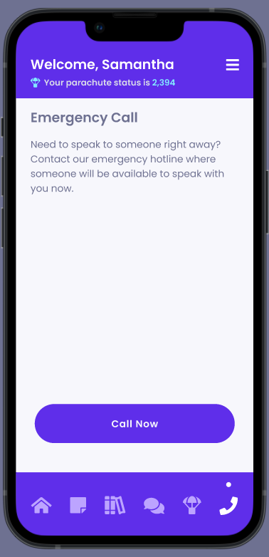
Building Resiliency
Notes:
Nurses are rewarded Parachute Points for completing activities related to wellness and reflection, completing their daily check-in, and accessing resources. Points are redeemable through rewards offered from an organization’s wellness program. And lastly, nurses who are in crisis can immediately access help when needed.

Slide 7
Optional Notifications
Building Resiliency
Scalability
Encouragement
Milestones
Reporting + Dashboard
Provider Network
All Nurses Grow
Users can turn on notifications for encouragement or affirmations
Users can turn on notifications for important milestones in their professional development
Refine the experiences of nurse leaders and preceptors/mentors to track vitality of those in their care
Expand directory of professionals (mental health practitioners, wellness coaches, etc.) and offer future telehealth visits
Expand resources to more care settings and/or offer to all nurses who deserve support and to grow. Increase content to include webinars + CE offerings
Notes:
Parachute provides optional notifications for encouragement, affirmations, and even milestones to see how a new nurse may be tracking in new professional skills. We hope to expand to offer telehealth visits in the future and to all nurses in all settings and eventually create a mentorship network.

Slide 8
Market Research
Building Resiliency
Benefits
Parachute
Fifth Window
Keener
Happy App
Moodfit
Care for
Caregivers
No app yet; they just finished beta testing
Currently free with paid features
Intuitive to Use
Yes
Yes
Yes
Yes
Free to new nurse
Organization fee
Yes, but a bit time consuming to set up
Appears to
be free
Cost to Use
Unclear
Free
Free
Platform
App
Website/App
App
App
App
Website/phone
New nurses
Preceptors
Nurse Leaders
Canadian Healthcare professionals
Users
All nurses
All nurses
All nurses
Anyone
Yes
Immediate community +
Mental health practitioners +
Wellness professionals
Crisis hotline
In theory, we called and no one answered
No. They do have PHQ-9 and GAD-7 embedded
Limited hours (no weekend or early morning/late night hours)
Real time
connection
No
No
Notes:
While wellness apps for nurses exist, we are unique from our competition because of our focus on nurses transitioning-to-practice. And additionally… (next slide)

Slide 9
Highlights
Building Resiliency
Parachute is special because of...
Convenient and accessible
On-demand connection
Responsive content requiring minimal work
Gamification and incentives
PARACHUTE
Notes:
Parachute is special because we make combating burnout accessible, provide on-demand help, use strategies to promote long-term behavioral changes by consistently engaging users, all while requiring very minimal work from the new nurse.

Slide 10
Building Resiliency
Implementation
Initial + Ongoing Costs
Business Model
Market Penetration
Universities and schools of nursing
Healthcare systems and hospital wellness programs
Recruitment and staffing agencies
Insurance companies
Recuperating costs
Profit Plan/Revenue Streams
Different costs associated with each tier based on number of users
Additional access to features
Marketing
Design/Creating Application
Ongoing Maintenance
Privacy Software
Grant funding (ANA, J&J, etc.)
PARACHUTE IS ALWAYS FREE TO ONBOARDING NURSES
Notes:
Our profit plan relies on receiving contracts from healthcare systems, universities, recruitment and staffing agencies, and insurance companies but our tenet is that Parachute is always free to onboarding nurses.

Slide 11

We need you.
Building Resiliency
PARACHUTE
Our workforce needs you.
The future of nursing needs you.
Notes:
Let me ask the audience this: the same strategies of traditional onboarding programs haven’t worked for years and we are losing nurses faster than we can train them. It’s time we make resources for combating experiences such as burnout, compassion fatigue, and moral distress readily available and truly centered around the new nurse’s experience. If we don’t provide nurses an opportunity to softly land into the profession, we will never retain them, despite training and replacing our aging workforce. What compassionate and mentally well caregivers will be left to take care of you?

Slide 12
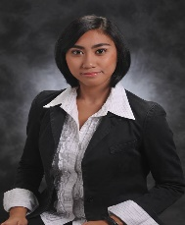
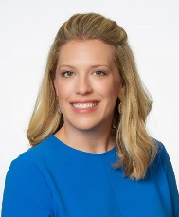

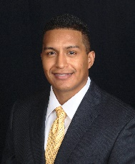
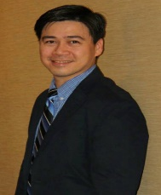
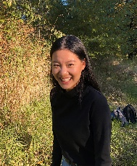

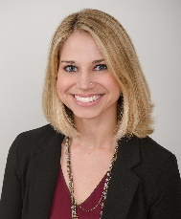

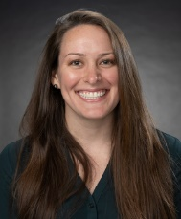
Building Resiliency
Our Team
with special thanks to Dan Terry, Senior UX Designer at Mad*Pow and Ellie Ericson BSN, RN
Danika Meyer MSN, RN, NPD-BC, CPN
CEO & Founder
NPD Specialist
Digital Experience RN
Cook Children’s Healthcare System
Juan Floriano
Co-Founder
Accelerated BSN Student
Rutgers University
Anticipated Graduation, August 2022
Siena Guerrero MSN, RN
Co-Founder
Neurology/Neurosurgery Nurse
Texas Children’s Hospital
Emory Kent MSN, RN
Co-Founder
Director, Center for Nursing Excellence
Kindred at Home
Humana Chief Nursing Office
Ian B. Kirit MSN, RN, CEN
Co-Founder
Informatics Nurse Specialist
Dartmouth Hitchcock Medical Center
Lillian Li
Co-Founder
BSN Student
Trinity Western University
Vancouver General Hospital,
Denine Moody MSN, RN, CNML
Co-Founder
Nursing Administrative Specialist -Magnet
Texas Children’s Hospital
Violet Robb MSN, ARNP, FNP-C
Co-Founder
Sleep Medicine Nurse Practitioner
UW Harborview Medical Center
Nir Rosenberg MD, MBA
Co-Founder
Plastic Surgeon
Lecturer, School of Nursing - Israel
Alison Ryan MSN, ARNP, FNP-C
Co-Founder
High Risk Screening and Genetics Nurse Practitioner
UW Valley Medical Center

Slide 13

Icon for Parachute logo taken from Good Ware from Flaticon.com

